Slide 1
HTTP and APIs
AI2C Techs

Slide 2
HyperText Transfer Protocol
Specified in RFC 1945 (May 1996!)
Consists of clients, servers, requests, and responses
"The language of the web"
Improvements and modifications over time
Notes:
https://www.rfc-editor.org/rfc/rfc1945

Slide 3
The HTTP Protocol: Rules
Client (i.e., browser) always initiates
Server responds, is always listening
One request, one response: Each HTTP exchange is complete
Stateless: Server doesn't remember previous requests (hence cookies needed)
Notes:
HTTP has four fundamental rules that govern how communication works. First, the client always initiates. Browsers start every conversation. Second, the server always responds. It must reply to every request, even if just to say 'error'. Third, it's one request, one response. Each HTTP exchange is complete in itself. Fourth, and most importantly, HTTP is stateless - the server doesn't remember previous requests. This is why cookies exist. Without them, you'd have to log in for every single page you visit.

Slide 4
Examples
Line
Headers
Body
Request
Response
GET /test HTTP/1.1\r\n
Host: example.com\r\n
Accept: */*\r\n
\r\n
{"param"="hello"}\r\n
HTTP/1.1 404 Not Found\r\n
Server: Apache/2.0.52\r\n
Accept-Ranges: bytes\r\n
Content-Length: 2652\r\n
Content-Type: text/html;\r\n
\r\n
<!doctype html><html ...
Notes:
GET /test HTTP/1.1
Host: example.com
Accept: */*
{"param"="hello"}

Slide 5
Methods and Codes
Request Methods
Response Status Code
Method = "GET”;
| "HEAD";
| "POST";
| extension-method
Status-Code= "200" ; OK
| "201" ; Created
| "202" ; Accepted
| "204" ; No Content
| "301" ; Moved Permanently
| "302" ; Moved Temporarily
| "304" ; Not Modified
| "400" ; Bad Request
| "401" ; Unauthorized
| "403" ; Forbidden
| "404" ; Not Found
| "500" ; Internal Server Error
| "501" ; Not Implemented
| "502" ; Bad Gateway
| "503" ; Service Unavailable
| extension-code
https://developer.mozilla.org/en-US/docs/Web/HTTP/Reference/Status
Notes:
https://www.rfc-editor.org/rfc/rfc1945#section-5

Slide 6
HTTP Tools
telnet
wget
curl
postman
requests
Wireshark
Browser (dev tools too!)
Demo
Notes:
Hit an HTTP that returns HTML and one that returns a JSON response

Slide 7
In python
Uses the requests library
https://docs.python-requests.org/en/latest/user/quickstart/#make-a-request
Demo

Slide 8
More Than Text
Have you ever seen an image online?
Have you ever seen a video?
Other formats??

Slide 9
Encoding Text
Remember all data is binary
Computer must represent data consistently
An encoding specifies the data representation
Character | UTF-8 (Binary) | Windows-1252 (Binary) | UTF-16LE (Binary)
A | 01000001 | 01000001 | 01000001 00000000
é | 11000011 10101001 | 11101001 | 00101001 00000110
€ | 11100010 10000010 10101100 | 10000000 | 00001010 00100000
" | 11100010 10000000 10011100 | 10010100 | 01000000 01001111

Slide 10
Base64 Encoding
Common HTTP encoding type
Converts every 6 bits into a character (2^6 options…)
A-Z
a-z
0-9
/+
Every 3 bytes → 4 characters
Notes:
https://base64.dev/articles/what-is-base64

Slide 11
Python Base64
Demo converting an image and some text
Notes:
base64.b64encode
base64.b64decode

Slide 12
Hands-On #1

Slide 13
API Terms
Path
Query String
Body
Request
GET /users/{user}/playlists?sort={direction} HTTP/1.1\r\n
Host: example.com\r\n
Authentication: "Bearer 1234deadb33f"
Accept: */*\r\n
\r\n
{"genre": "rock"}\r\n
Notes:
GET /test HTTP/1.1
Host: example.com
Accept: */*
{"param"="hello"}

Slide 14
Reading API Docs
PayPal example

Slide 15
Reading API Docs
In groups:
Endpoint, e.g. https://api.github.com/repos/{owner}/{repo}/commits
Required parameters (path, body, or query string?)
Optional parameters (path, body, or query string?)
How do they handle multiple responses (e.g. 1000 commits)?
Groups:
Compare two commits in GitHub
Plan a route using Google Maps
See my abandoned carts in Shopify
Create a new Spotify playlist

Slide 16
Authentication
Authorization vs Authentication?
How does a stateless protocol handle authentication?

Slide 17
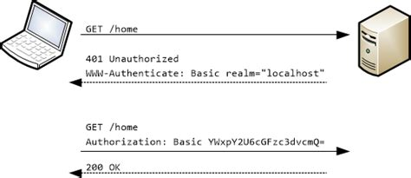
Basic Authentication
username:password
Base64 encoded
Notes:
Pros:
Simple
Stateless
User-specific
Cons;
Sending password repeatedly
Cannot auth 3rd parties

Slide 18
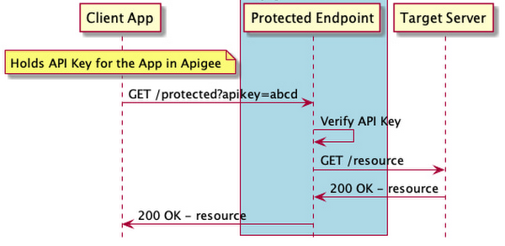
Key/Token Authentication
Notes:
Pros:
Simple
Stateless
Can auth 3rd parties
Cons;
Hard to rotate keys
Generally not user-specific

Slide 19
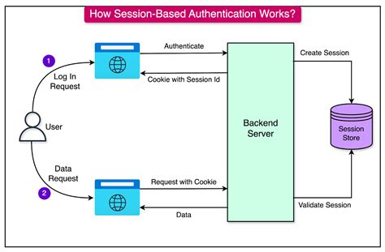
Session Cookies
Notes:
Pros:
Simple
User-specific
Cons:
Stateful
Cannot auth 3rd parties

Slide 20
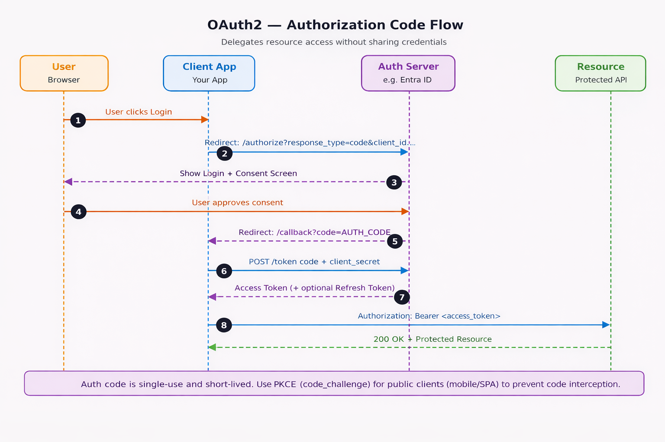
OAUTH
Notes:
Pros:
Limited scope / time
User-specific
Can auth 3rd parties
Cons:
Complexity
https://www.c-sharpcorner.com/article/a-net-developers-complete-guide-to-choose-right-authentication-from-basic-aut/

Slide 21
In General…
How long does the token live?
Who generates the token?
Who maintains (revokes) the token?
What resource is the token for?
Is the token stateless or stateful?
Notes:
https://medium.com/@reddyyashu20/beginners-guide-to-fastapi-openai-chatgpt-api-integration-50a0c3b8571e

Slide 22
Hands-On #2

Slide 23
Questions

